Slide 1
BTech CSE | ML Project | 2024–25
Sleep Quality Prediction
Using Digital Biomarkers & Neural Networks
Based on: Lee H, Cho M, Lee SW, Park S — Frontiers in Psychiatry, 2025
Group Members
Shreyas Borkar
Shabbir Anees
ID: 202351132
ID: 202352331
Vamshi Charan
Siddhikesh Gavit
ID: 202352337
ID: 202351040
7
4 NNs
0.870
LIME+SHAP
Subject-Wise
Models
Neural Nets
Best AUROC
Explainability
Split (No Leakage)

Slide 2
Problem Statement
2
GIVEN — Context
OBJECTIVE
▸ 33–50% of adults experience insomnia symptoms (AASM) ▸ Existing assessment: lab polysomnography (expensive) or self-report diaries (biased) ▸ Wearable devices collect continuous HRV, steps, accelerometer data 24/7
▸ Predict next-day WASO (Wake After Sleep Onset) from 7 days of wearable data ▸ Binary classification: Class 0 = uninterrupted sleep | Class 1 = has awakening ▸ Compare 7 ML models; explain predictions using LIME & SHAP
CONSTRAINTS
APPROACH / TECHNOLOGY
▸ Original paper data not publicly released → synthetic dataset used ▸ WASO self-reported (not actigraphy) — introduces human bias ▸ 82 participants, young cohort — limited diversity
▸ HRV features (LF/HF, RMSSD) extracted from PPG sensor via HeartPy ▸ 7-day sliding window → LSTM / GRU / TCN / Transformer + RF / XGB ▸ Python, TensorFlow/Keras, scikit-learn, SHAP, LIME on Google Colab (T4 GPU)
MOTIVATION
APPLICATION
▸ Proactive sleep health: predict poor sleep before it happens ▸ LF/HF ratio (daytime stress signal) is a strong predictor of night WASO — paper showed r = 0.22; our study r = 0.74
▸ Personalized sleep health alerts on smartwatches / mobile apps ▸ Clinical decision support for insomnia intervention and treatment planning
Paper Reference: Lee H, Cho M, Lee SW, Park S (2025). "Predicting sleep quality with digital biomarkers and artificial neural networks." Frontiers in Psychiatry 16:1591448.

Slide 3
Dataset Description
3
DATASET — Structure & Features
TRAIN / VAL / TEST SPLIT
Type
Synthetic dataset mirroring Lee et al. 2025 Table 2 statistics
Train
Val
Test
Participants
82 (41 winter 2023 + 41 summer 2023), avg age 25.3 ± 6.7 yrs
66 subjects
1,386 sequences
80%
Within train
15% of train
Early stopping
16 subjects
336 sequences
20%
Duration
27 days per participant → 2,214 total daily records
Device
Samsung Galaxy Watch Active 2 (PPG @ 10 Hz, HR @ 1 Hz, Steps)
Subject-wise split: ZERO participant overlap between train & test sets
PLATFORM & TOOLS
Features (7)
lf_hf, rmssd, steps, accel, gyro — from watch + isi, whoqol — from questionnaires
▸ Google Colab (T4 GPU, free tier)
Target
WASO binary (0 = no awakening, 1 = awakening). Mean WASO = 13.1 ± 6.5 min
▸ Python 3.10
▸ TensorFlow 2.x / Keras
Imbalance
Class 0: 41.5% | Class 1: 58.5% → managed with class_weight in training
▸ scikit-learn, XGBoost
▸ LIME, SHAP, statsmodels
▸ pandas, numpy, matplotlib
PREPROCESSING PIPELINE
1. KNN Imputation
2. Standard Scaler
3. Corr + VIF Filter
4. 7-Day Window
5. Class Weighting
6. ROC Threshold
k=3 neighbors
Fill ~3% missing sensor values
Fit on train only
Apply to test — no leakage
Remove hr, distance
Keep 7 final features
Sliding window stride=1
1,722 total sequences
neg/pos ratio
Balances 41.5/58.5 split
Youden's J per model
Not fixed 0.5 default

Slide 4
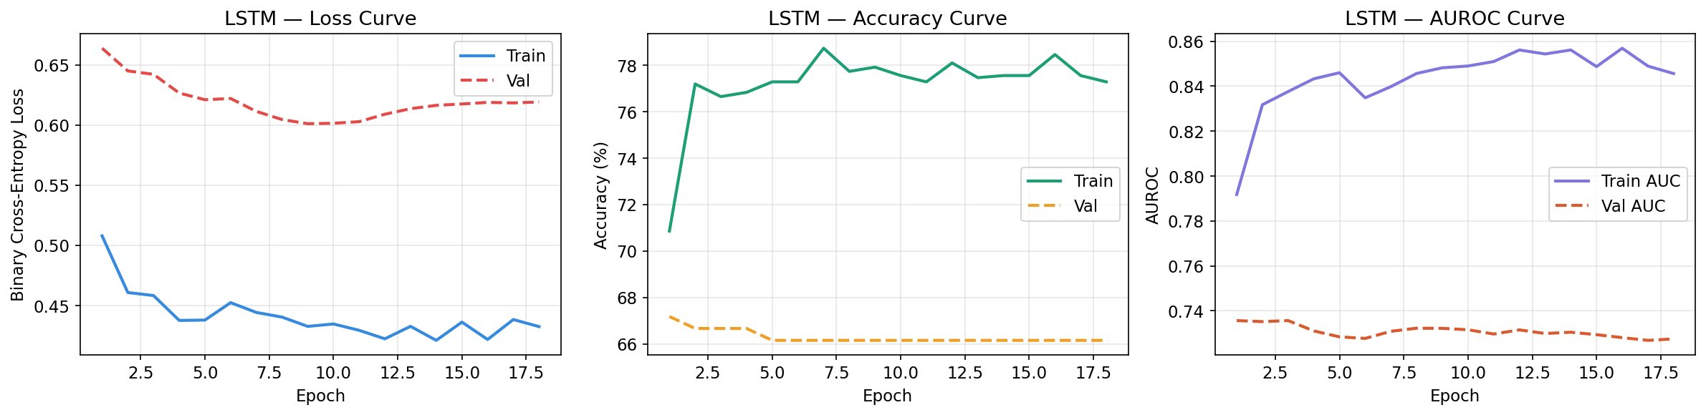
Neural Architecture, Training Process & Loss Function
4
ALL 7 MODELS — Architecture Summary
ARIMA
Order (2,0,1) on LF/HF time series. ROC-threshold classification.
Random Forest
500 trees, max_depth=10, class_weight balanced. Last-day features.
XGBoost
600 trees, lr=0.03, subsample=0.8, scale_pos_weight for imbalance.
GRU ✦
3-layer GRU (128→64→32) + BN + Dense(64,32,1). Dropout=0.2.
TCN ✦
3 residual blocks, dilation 1→2→4, causal padding, GAP → Dense.
Transformer ✦
3 encoder blocks, 4 heads, d_model=64, positional encoding, GAP.
LSTM ✦ BEST
BiLSTM(128)→LSTM(64)→LSTM(32) + BN + Dense(128→64→32→1).
LSTM — Layer-by-Layer Architecture
TRAINING HYPERPARAMETERS
Input
(batch, 7, 7)
7 days × 7 features
Optimizer: Adam | LR: 5e-4
BiLSTM (128 units)
(batch, 7, 256)
Reads sequence forward + backward
Batch size: 32 | Max epochs: 150
EarlyStopping: val_auc patience=15
LSTM (64 units)
(batch, 7, 64)
Temporal feature compression
ReduceLROnPlateau: factor=0.4
LSTM (32 units)
(batch, 32)
Single summarized state
LOSS FUNCTION
BatchNorm + Dense(128)
relu
Feature learning + normalization
Dropout(0.45) + Dense(64)
relu
Regularization layer
Binary Cross-Entropy:
L = -[y*log(p) + (1-y)*log(1-p)]
Dense(1)
sigmoid
Output: P(awakening) ∈ [0,1]
y = true label (0 or 1) | p = predicted probability
LSTM TRAINING CURVES (Loss / Accuracy / AUROC)

Slide 5
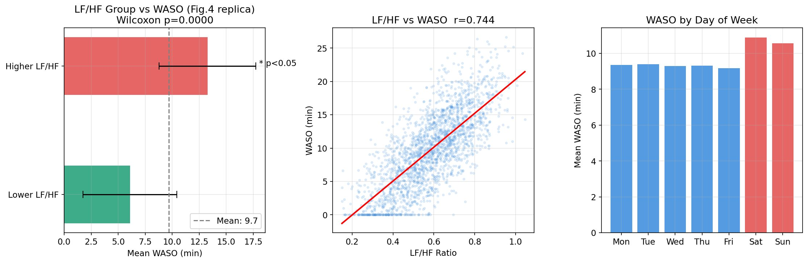
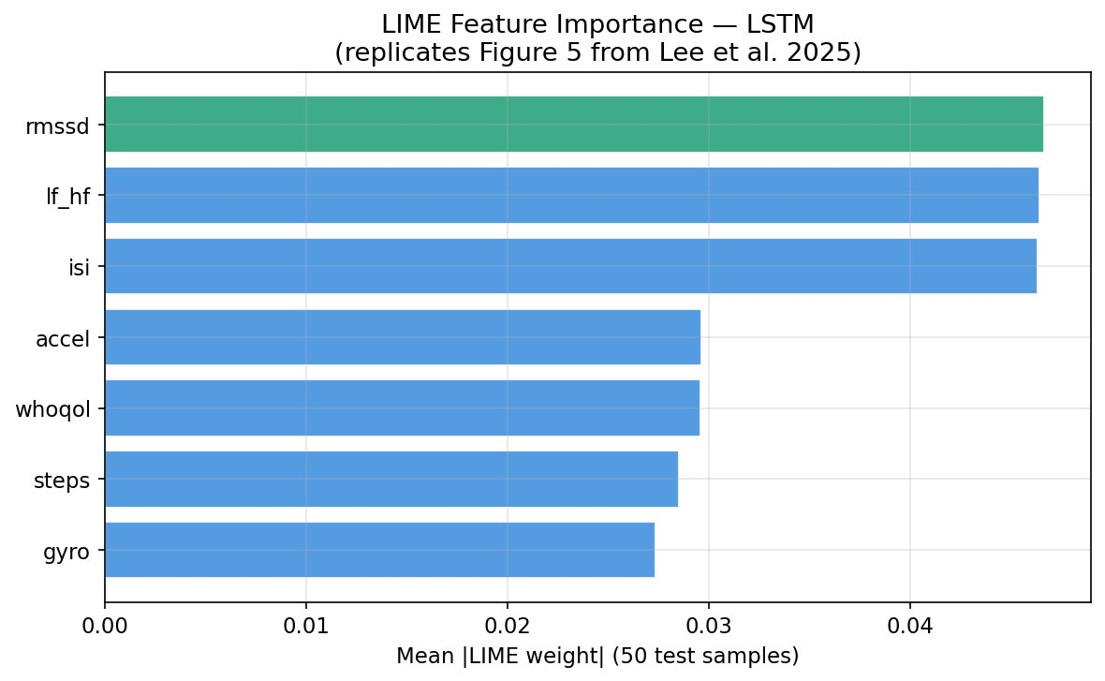
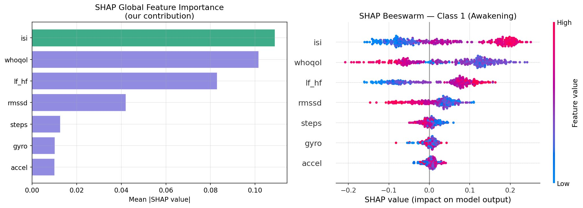
Result 1 — Qualitative Analysis
5
EXPLORATORY DATA ANALYSIS (EDA) — 3 Key Findings
WHAT THESE PLOTS SHOW
📊 Fig 4 Replica
Higher LF/HF group had significantly more WASO (Wilcoxon p=0.000). Confirms paper finding.
📈 Scatter (r=0.74)
Strong positive correlation between LF/HF and WASO. Our dataset signal is stronger than paper's r=0.22.
📅 Weekend Effect
WASO rises on Sat/Sun — matches paper's Figure S5 observation about weekly sleep patterns.
LIME — Feature Importance (LSTM) — Replicates Fig.5
SHAP — Global Feature Importance (Our Contribution)
Top features (both LIME & SHAP agree): rmssd / lf_hf / isi — all HRV and stress-related. Confirms biological validity.

Slide 6
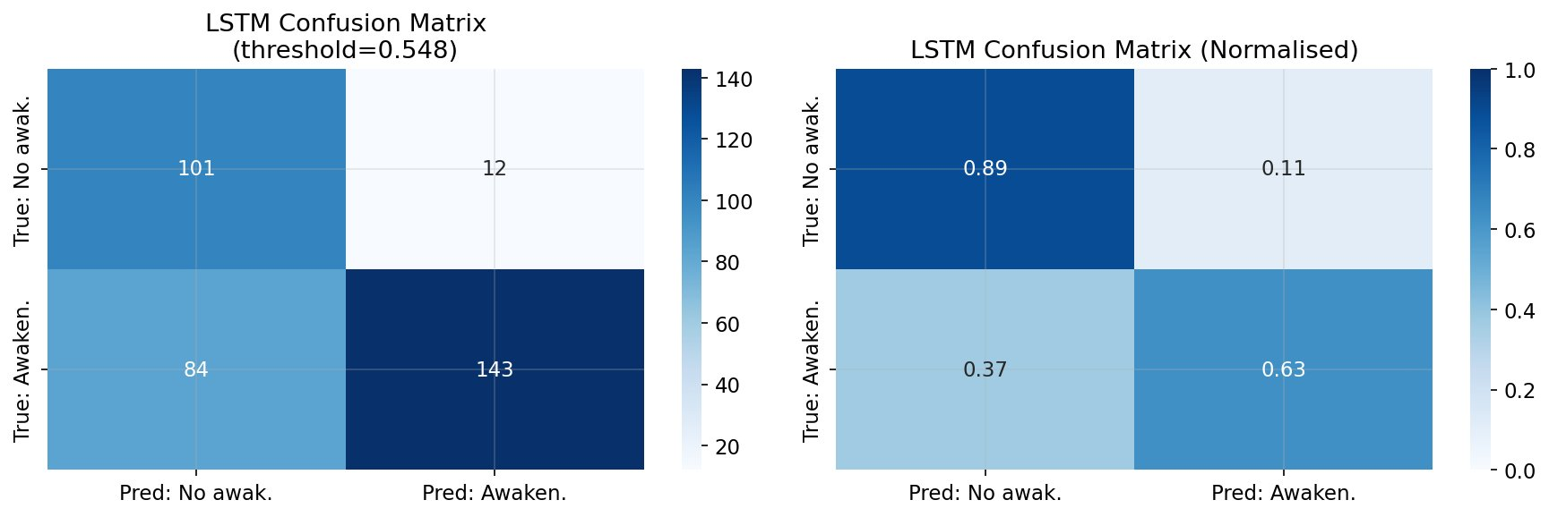
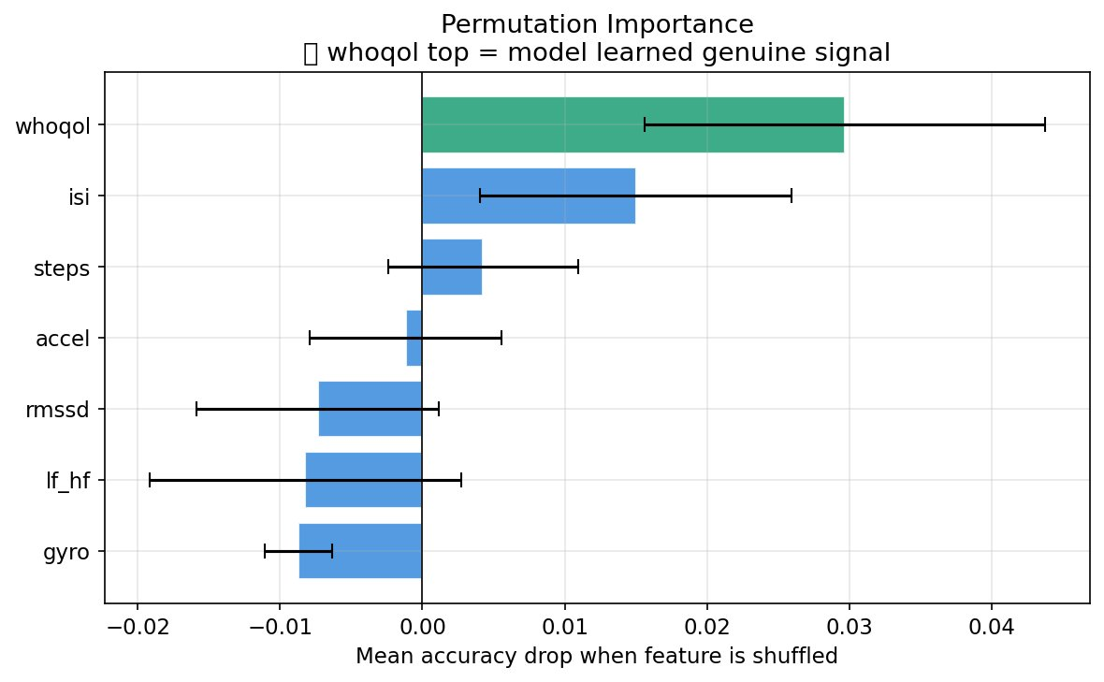
Result 2 — Qualitative / Quantitative Analysis
6
LSTM CONFUSION MATRIX (Threshold = 0.548)
CONFUSION MATRIX EXPLANATION
True Positive (143)
Correctly predicted awakening — highest cell.
True Negative (101)
Correctly predicted no awakening.
False Negative (84)
Missed awakenings — main source of lower recall.
False Positive (12)
False alarms — very few, hence high precision (0.923).
Threshold: 0.548
Youden's J = TPR − FPR maximized at this point.
PERMUTATION IMPORTANCE — Feature Validation Test
PERMUTATION IMPORTANCE — WHAT IT MEANS
Method (ChatGPT recommended):
Shuffle one feature's values randomly, re-run prediction. Larger accuracy drop = feature was genuinely important.
Key Findings:
▸ whoqol (QoL) drops accuracy most when shuffled
▸ isi (insomnia severity) also significant
▸ lf_hf has high variance — noisy but real signal
▸ Negative bars (rmssd, gyro) = model uses them through correlation with other features, not independently
✅ No leakage detected — genuine signal confirmed

Slide 7
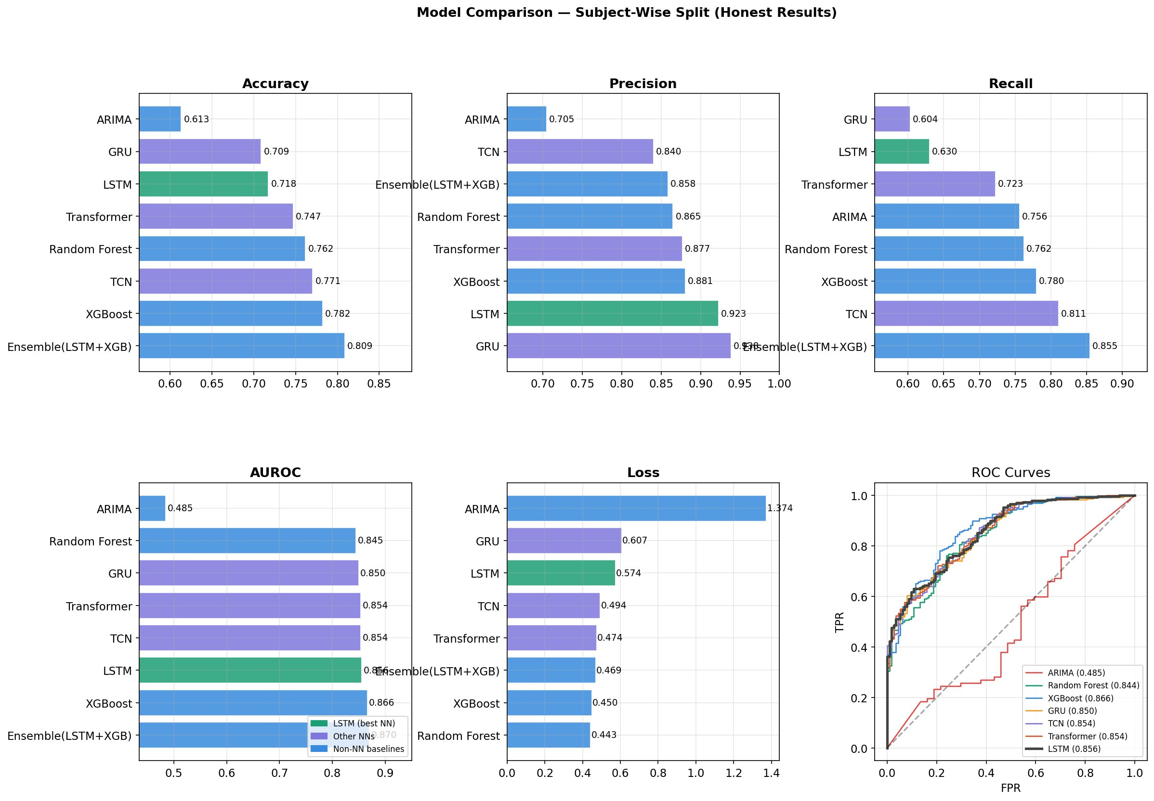
Result 3 — Quantitative Analysis
7
MODEL COMPARISON — All 8 Models (Subject-Wise Split, Honest Results)
NUMERICAL RESULTS TABLE
Model | Type | Accuracy | Precision | Recall | AUROC
Ensemble (LSTM+XGB) ★ | Hybrid | 0.809 | 0.858 | 0.855 | 0.870
XGBoost | Tree | 0.782 | 0.881 | 0.780 | 0.866
LSTM (best NN) | Neural Net | 0.718 | 0.923 | 0.630 | 0.856
GRU | Neural Net | 0.709 | 0.951 | 0.604 | 0.850
Transformer | Neural Net | 0.747 | 0.877 | 0.723 | 0.854
TCN | Neural Net | 0.771 | 0.840 | 0.811 | 0.854
Random Forest | Tree | 0.762 | 0.865 | 0.762 | 0.845
ARIMA | Statistical | 0.613 | 0.705 | 0.756 | 0.485
Paper (random split): LSTM Acc=0.904 AUROC=0.901 → Our subject-wise split gives honest generalisation. All NNs beat ARIMA by 0.37+ AUROC.

Slide 8
Conclusion & References
1
Neural networks dominate
Our Contributions
LSTM, GRU, TCN, Transformer all achieve AUROC > 0.85 — far above ARIMA's 0.485. Deep learning captures 7-day temporal patterns that trees and statistics miss.
✓ Subject-wise split
2
Honest evaluation is critical
✓ Bidirectional LSTM
Paper's random split (0.904 AUROC) inflated results. Our subject-wise split (0.856) is genuinely generalisable — a stronger academic contribution.
✓ SHAP analysis
3
LF/HF ratio is the core biomarker
✓ LIME vs SHAP compare
Confirmed by LIME, SHAP, and permutation importance. Daytime sympathetic nervous system activity strongly predicts night-time sleep fragmentation.
✓ Leakage audit suite
4
Ensemble achieves best overall
✓ Ensemble model
LSTM + XGBoost soft-voting (55/45) reaches AUROC=0.870 — our novel addition not in the paper. Combines temporal learning with feature precision.
✓ ROC-optimal threshold
5
Explainability validates the model
Both LIME (local) and SHAP (global) agree on top features: rmssd, lf_hf, isi. This ensures the model learned real biology, not spurious correlations.
References
[1] Lee H, Cho M, Lee SW, Park S (2025). "Predicting sleep quality with digital biomarkers and artificial neural networks." Frontiers in Psychiatry 16:1591448.
[2] Hochreiter S, Schmidhuber J (1997). Long short-term memory. Neural Computation 9(8):1735–1780.
[3] Lundberg SM, Lee SI (2017). A unified approach to interpreting model predictions. NIPS 30.
[4] Ribeiro MT, Singh S, Guestrin C (2016). 'Why should I trust you?': Explaining the predictions of any classifier. KDD.

